Slide 1
Ridge and Lasso - Hyperparameters

Slide 2
Discussion:

Slide 3
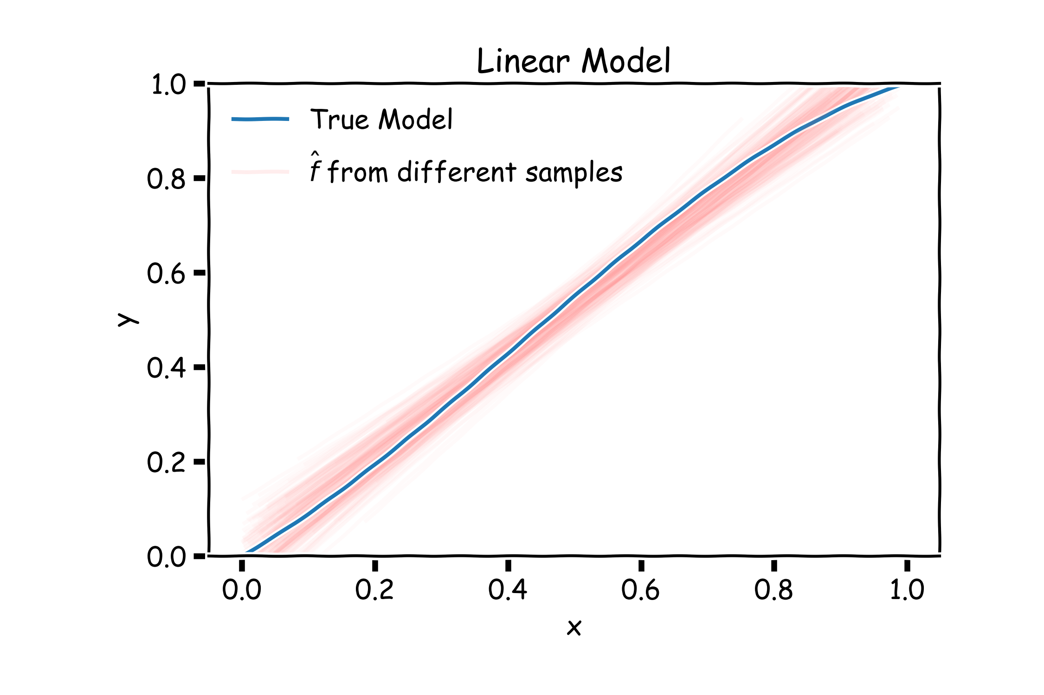
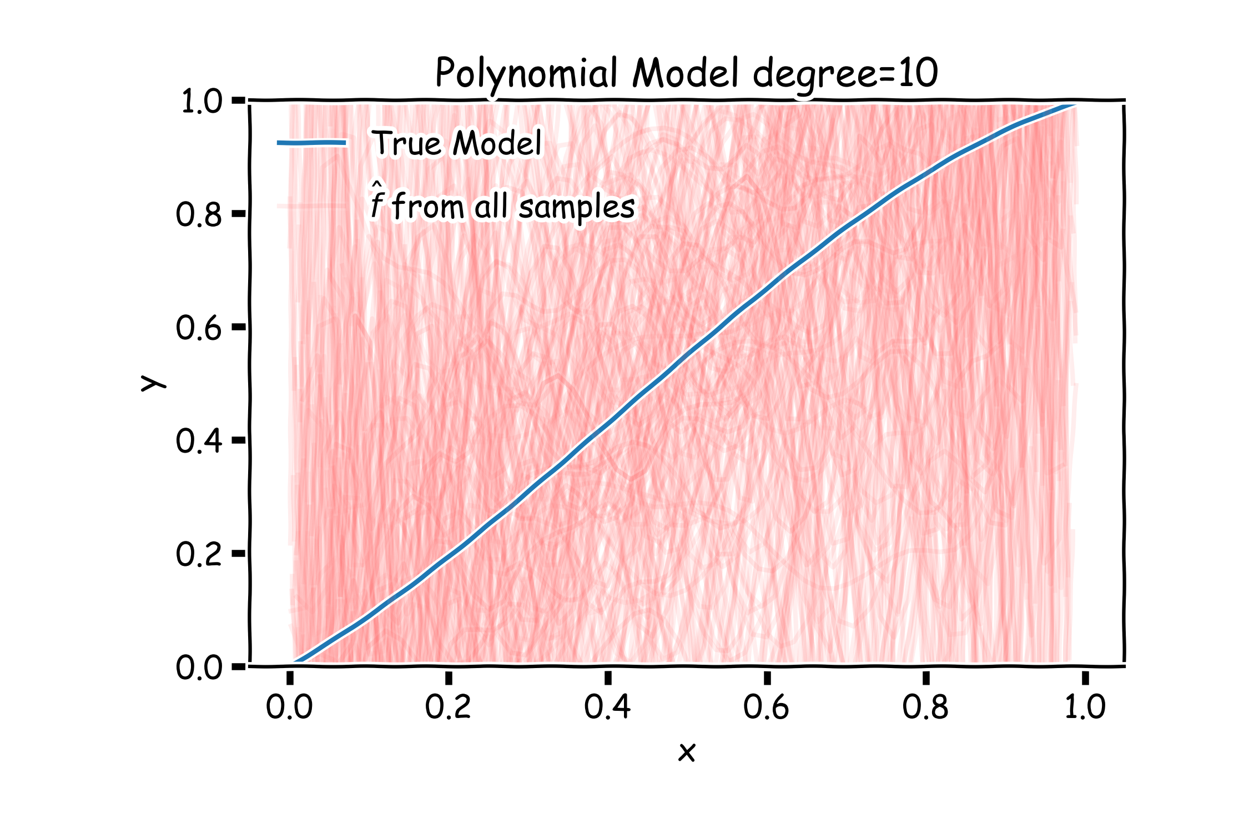
Bias vs Variance
Left: 2000 best fit straight lines, each fitted on a different 20 point training set.
Right: Best-fit models using degree 10 polynomial

Slide 4
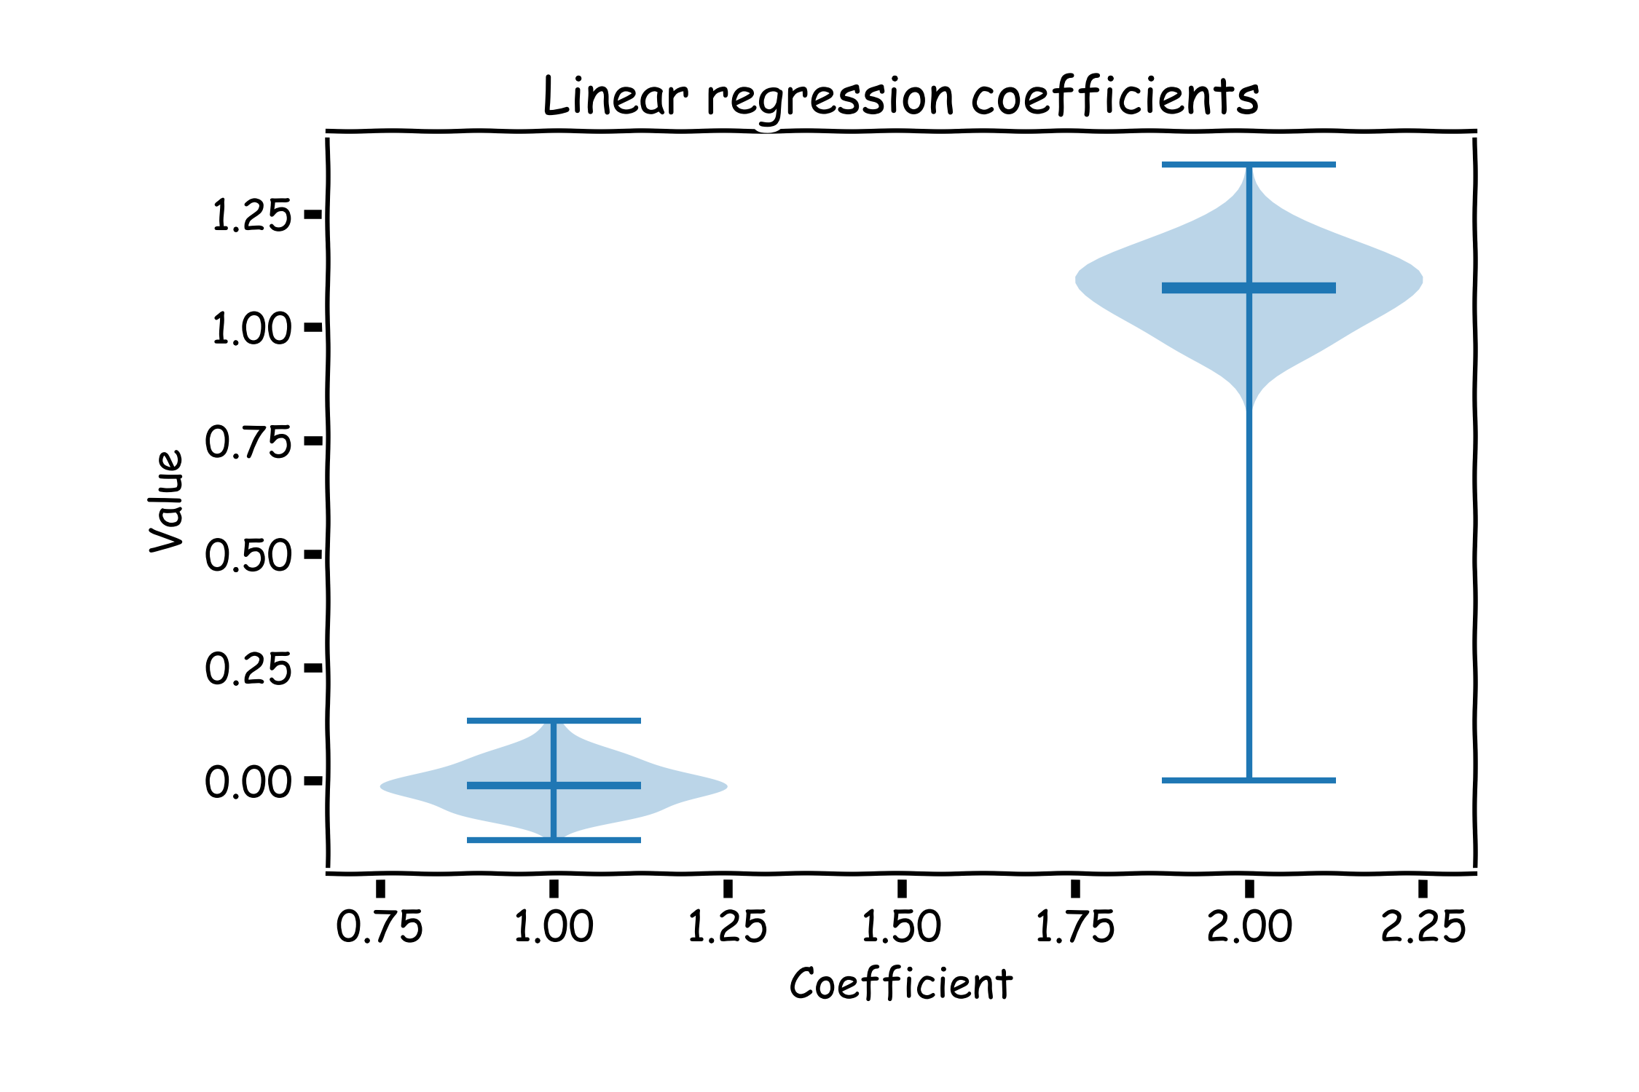
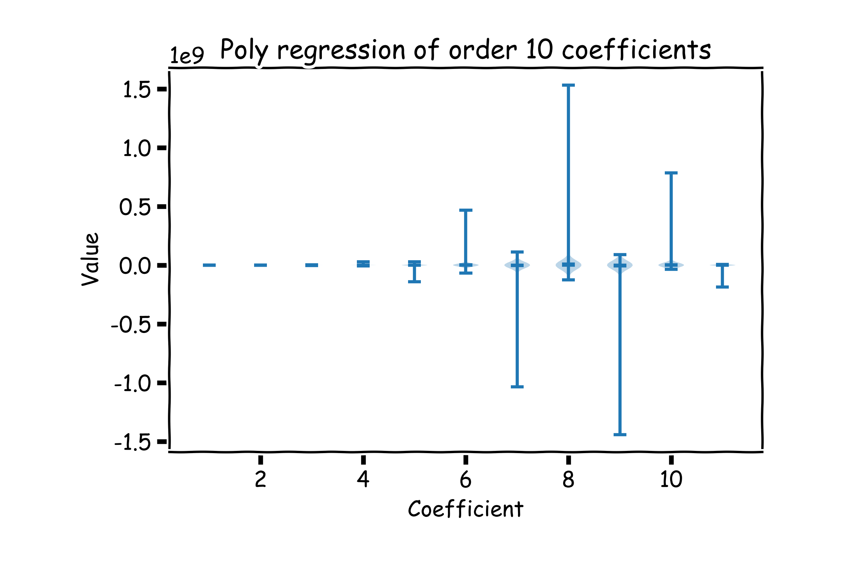
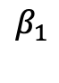
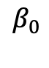
Bias vs Variance
Left: Linear regression coefficients
Right: Poly regression of order 10 coefficients
$$β_{0}$$
$$β_{1}$$

Slide 5
LASSO Regression
Since we wish to discourage extreme values in model parameter, we need to choose a regularization term that penalizes parameter magnitudes. For our loss function, we will again use MSE.
Together our regularized loss function is:
Note that is the l₁ norm of the vector β

Slide 6
Ridge Regression
Alternatively, we can choose a regularization term that penalizes the squares of the parameter magnitudes. Then, our regularized loss function is:
Note that is the square of the l₂ norm of the vector β

Slide 10
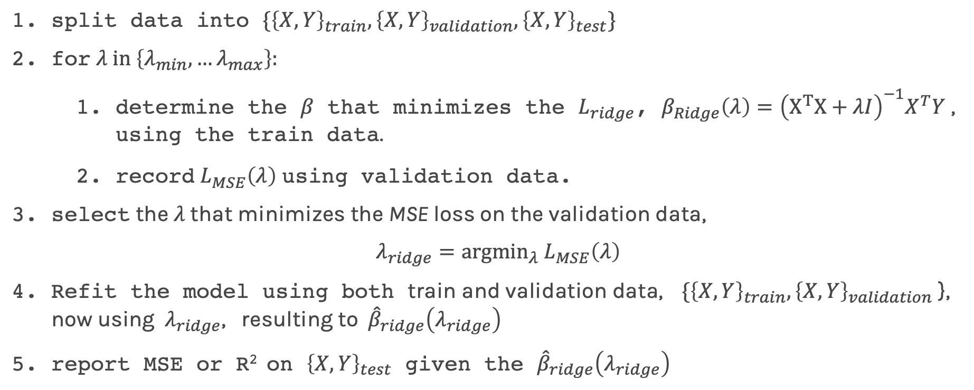
Ridge regularization with only validation : step by step
For ridge regression there exist an analytical solution for the coefficients:
${\hat{β}}_{Ridge}\left(λ\right)={\left(X^{T}X+λI\right)}^{−1}X^{T}Y$
split data into $\{{\left\{X,Y\right\}}_{train},{\left\{X,Y\right\}}_{validation},{\left\{X,Y\right\}}_{test}\}$
for $λ in \left\{λ_{min},…λ_{max}\right\}:$
determine the $β$ that minimizes the $L_{ridge}$, $β_{Ridge}\left(λ\right)={\left(X^{T}X+λI\right)}^{−1}X^{T}Y$ , using the train data.
record $L_{MSE}^{}\left(λ\right)$ using validation data.
select the $λ$that minimizes the MSE loss on the validation data,
$$λ_{ridge}={argmin}_{λ} L_{MSE}^{}\left(λ\right)$$
Refit the model using both train and validation data, $\{{\left\{X,Y\right\}}_{train},{\left\{X,Y\right\}}_{validation}$ }, now using $λ_{ridge}$, resulting to ${\hat{β}}_{ridge}\left(λ_{ridge}\right)$
report MSE or R² on ${\left\{X,Y\right\}}_{test}$ given the ${\hat{β}}_{ridge}\left(λ_{ridge}\right)$

Slide 11
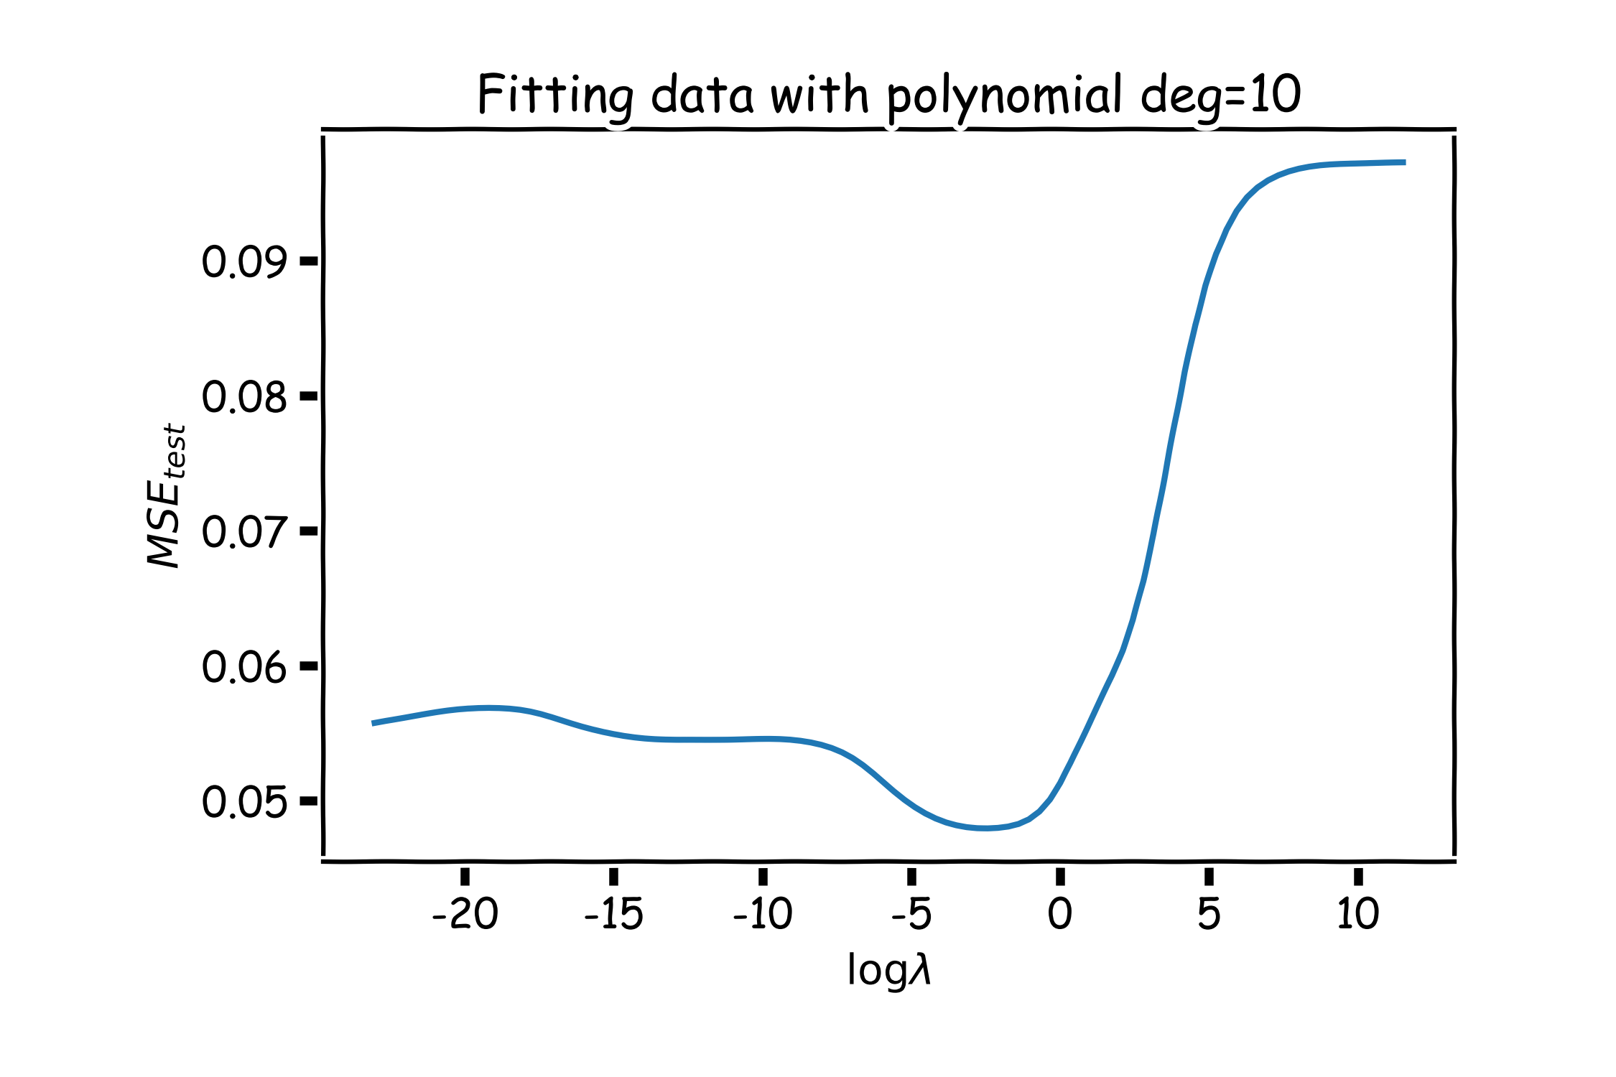
Ridge regularization with validation only
val

Slide 12
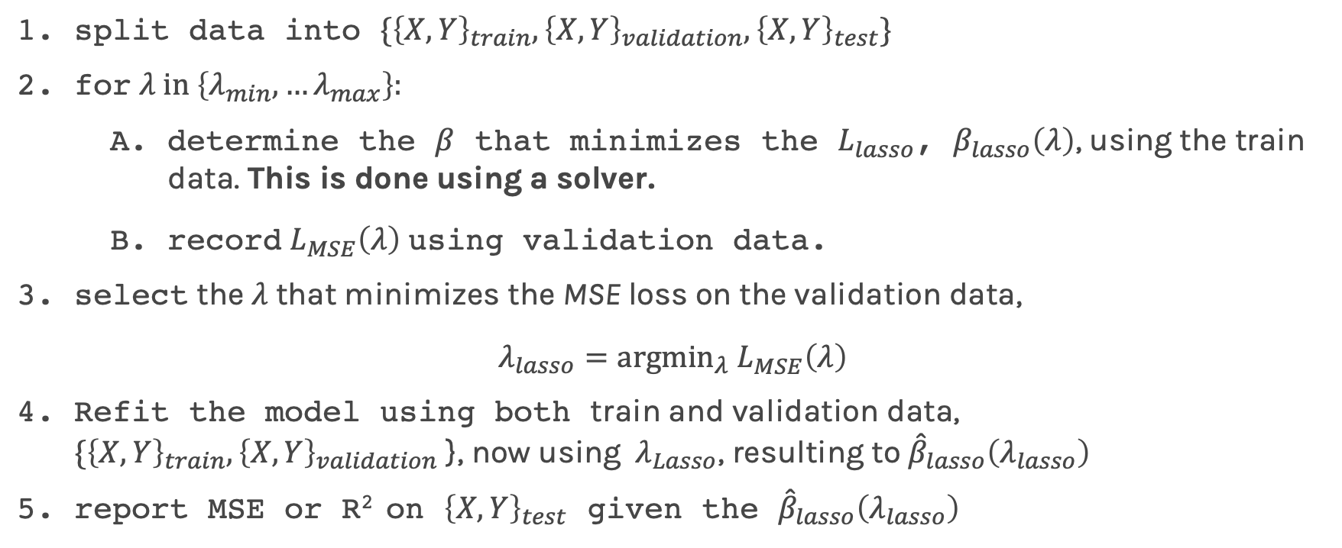
Lasso regularization with validation only: step by step
For Lasso regression, there is no analytical solution for the coefficients, so we use a solver.
split data into $\{{\left\{X,Y\right\}}_{train},{\left\{X,Y\right\}}_{validation},{\left\{X,Y\right\}}_{test}\}$
for $λ in \left\{λ_{min},…λ_{max}\right\}:$
determine the $β$ that minimizes the $L_{lasso}$, $β_{lasso}\left(λ\right)$, using the train data. This is done using a solver.
record $L_{MSE}^{}\left(λ\right)$ using validation data.
select the $λ$that minimizes the MSE loss on the validation data,
$λ_{lasso}={argmin}_{λ} L_{MSE}^{}\left(λ\right)$
Refit the model using both train and validation data, $\{{\left\{X,Y\right\}}_{train},{\left\{X,Y\right\}}_{validation}$ }, now using $λ_{Lasso}$, resulting to ${\hat{β}}_{lasso}\left(λ_{lasso}\right)$
report MSE or R² on ${\left\{X,Y\right\}}_{test}$ given the ${\hat{β}}_{lasso}\left(λ_{lasso}\right)$

Slide 13
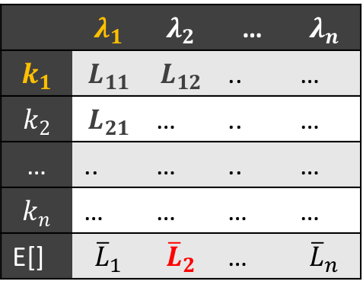
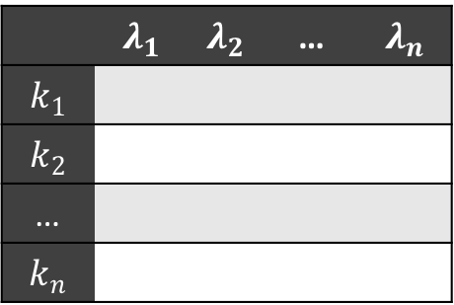
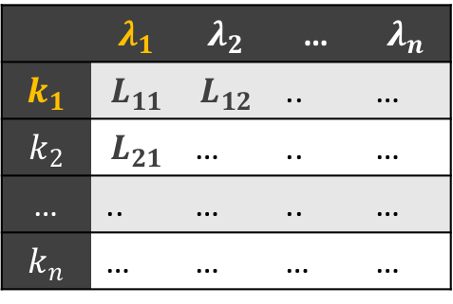
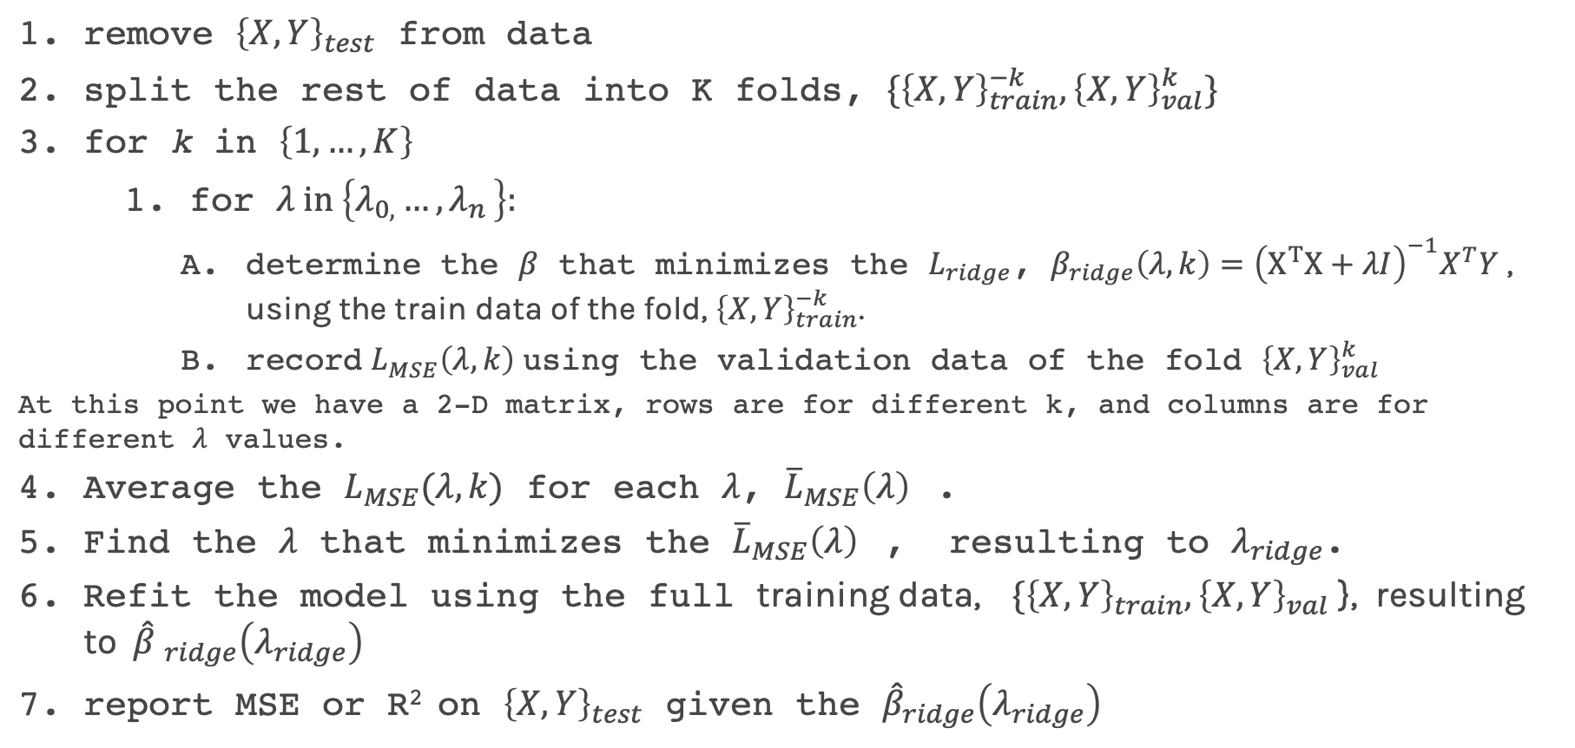
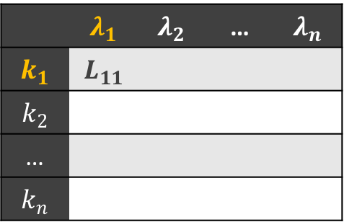
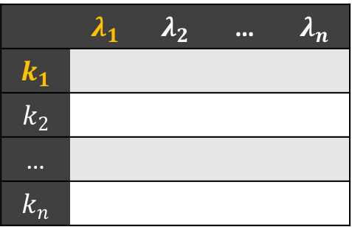
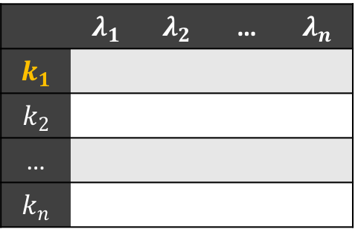
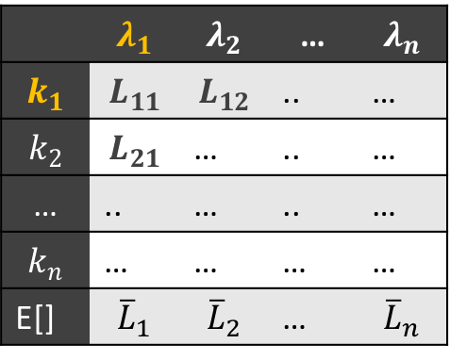
Ridge regularization with CV: step by step
 | $$λ_{1}$$ | $$λ_{2}$$ | … | $$λ_{n}$$
$$k_{1}$$
$$k_{2}$$
…
$$k_{n}$$
 | $$λ_{1}$$ | $$λ_{2}$$ | … | $$λ_{n}$$
$$k_{1}$$ | $$L_{11}$$ | $$L_{12}$$ | .. | …
$$k_{2}$$ | $$L_{21}$$ | … | .. | …
… | .. | … | .. | …
$$k_{n}$$ | … | … | … | …
E[] | $${\overline{L}}_{1}$$ | $${\overline{L}}_{2}$$ | … | $${\overline{L}}_{n}$$
 | $$λ_{1}$$ | $$λ_{2}$$ | … | $$λ_{n}$$
$$k_{1}$$
$$k_{2}$$
…
$$k_{n}$$
 | $$λ_{1}$$ | $$λ_{2}$$ | … | $$λ_{n}$$
$$k_{1}$$ | $$L_{11}$$ | $$L_{12}$$ | .. | …
$$k_{2}$$ | $$L_{21}$$ | … | .. | …
… | .. | … | .. | …
$$k_{n}$$ | … | … | … | …
 | $$λ_{1}$$ | $$λ_{2}$$ | … | $$λ_{n}$$
$$k_{1}$$ | $$L_{11}$$
$$k_{2}$$
…
$$k_{n}$$
 | $$λ_{1}$$ | $$λ_{2}$$ | … | $$λ_{n}$$
$$k_{1}$$ | $$L_{11}$$ | $$L_{12}$$ | .. | …
$$k_{2}$$ | $$L_{21}$$ | … | .. | …
… | .. | … | .. | …
$$k_{n}$$ | … | … | … | …
E[] | $${\overline{L}}_{1}$$ | $${\overline{L}}_{2}$$ | … | $${\overline{L}}_{n}$$
 | $$λ_{1}$$ | $$λ_{2}$$ | … | $$λ_{n}$$
$$k_{1}$$
$$k_{2}$$
…
$$k_{n}$$
remove ${\left\{X,Y\right\}}_{test}$ from data
split the rest of data into K folds, $\{{\left\{X,Y\right\}}_{train}^{−k},{\left\{X,Y\right\}}_{val}^{k}\}$
for k in $\left\{1,…,K\right\}$
for $λ in \left\{λ_{0,}…{, λ}_{n}\right\}:$
determine the $β$ that minimizes the $L_{ridge}$, $β_{ridge}\left(λ,k\right)={\left(X^{T}X+λI\right)}^{−1}X^{T}Y$ , using the train data of the fold, ${\left\{X,Y\right\}}_{train}^{−k}$.
record $L_{MSE}^{}\left(λ,k\right)$ using the validation data of the fold ${\left\{X,Y\right\}}_{val}^{k}$
At this point we have a 2-D matrix, rows are for different k, and columns are for different $λ$ values.
Average the $L_{MSE}(λ,k)$ for each $λ$, ${{\overline{L}}_{MSE}\left(λ\right)}_{}$.
Find the $λ$ that minimizes the ${{\overline{L}}_{MSE}\left(λ\right)}_{}$, resulting to $λ_{ridge}$.
Refit the model using the full training data, $\{{\left\{X,Y\right\}}_{train},{\left\{X,Y\right\}}_{val}$ }, resulting to ${\hat{β} }_{ridge}\left(λ_{ridge}\right)$
report MSE or R² on ${\left\{X,Y\right\}}_{test}$ given the ${\hat{β}}_{ridge}\left(λ_{ridge}\right)$

Slide 14
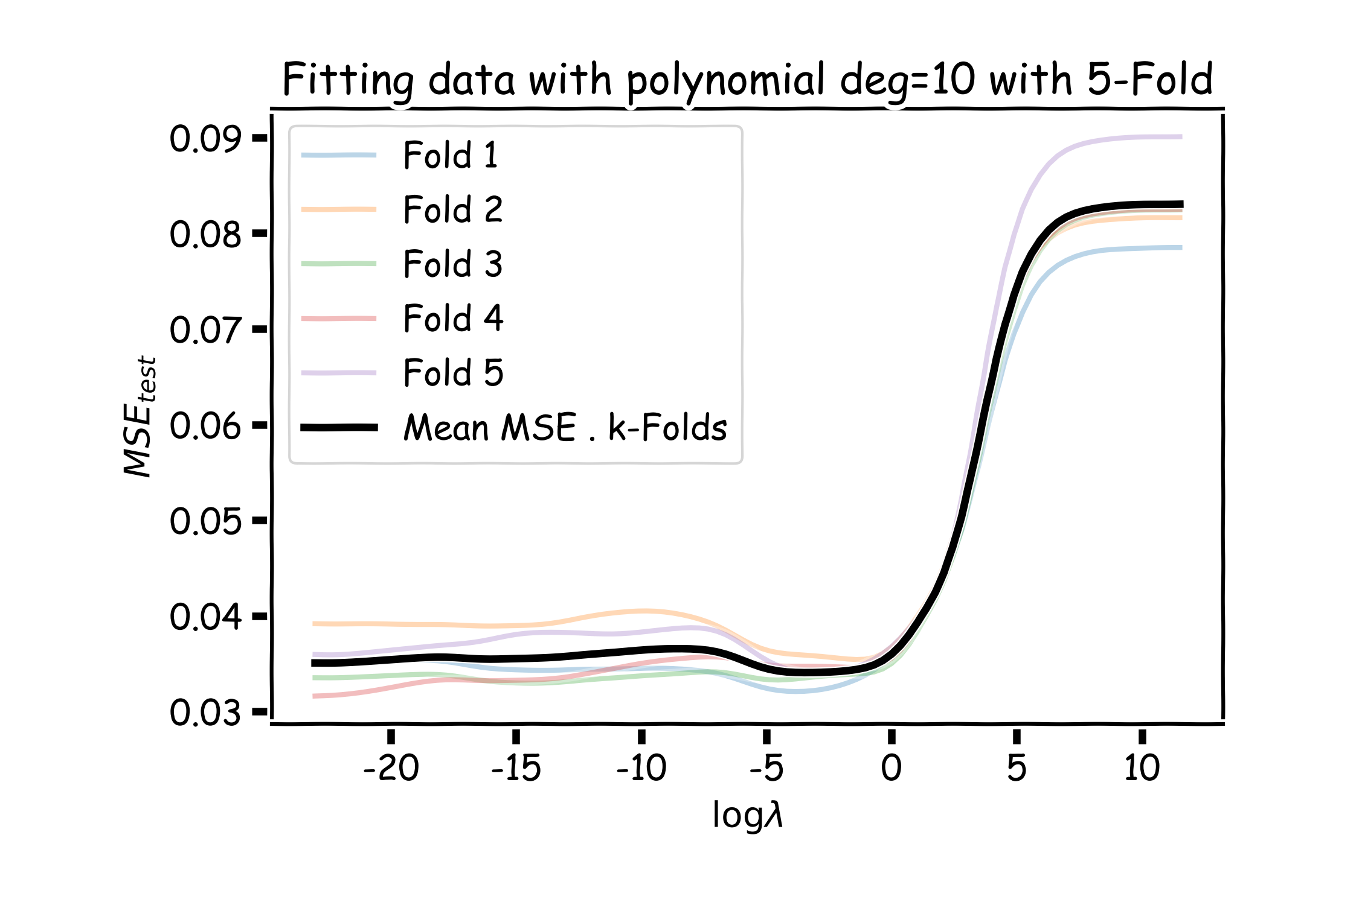
Ridge regularization with cross-validation only: step by step
val

Slide 16

What to do? 🤔
Today’s lucky student:
Student with the most letters in their name (first and last).
Instructions:
Watch the video and then go to your rooms
https://twitter.com/i/status/1161973951565881345

